Slide 1
CholoJai
Mobile Application
Group Members:
Md. Mominul Islam Shizan 18.02.04.117
Shohanur Rahman 18.02.04.127
Afridi Rahman Bondhon 18.02.04.128
Samina Mahjabeen 18.02.04.129
Mosiur Rahman 16.01.04.122

Slide 2
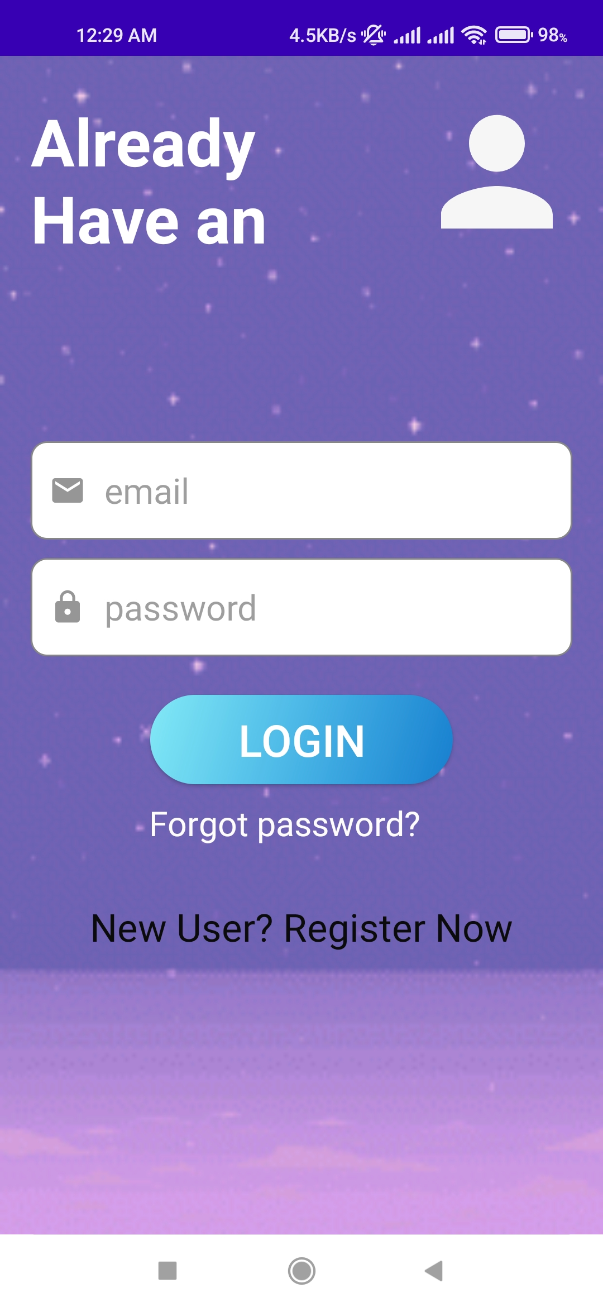
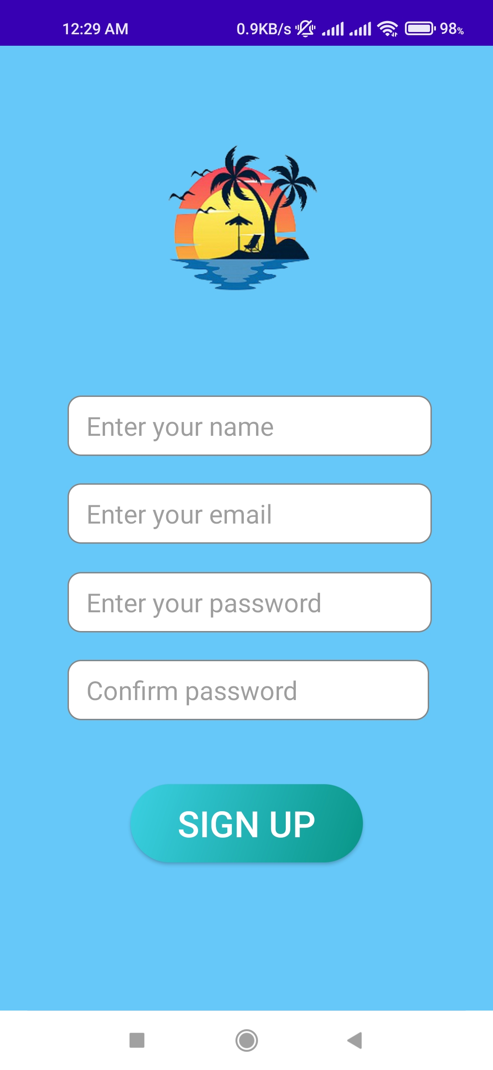
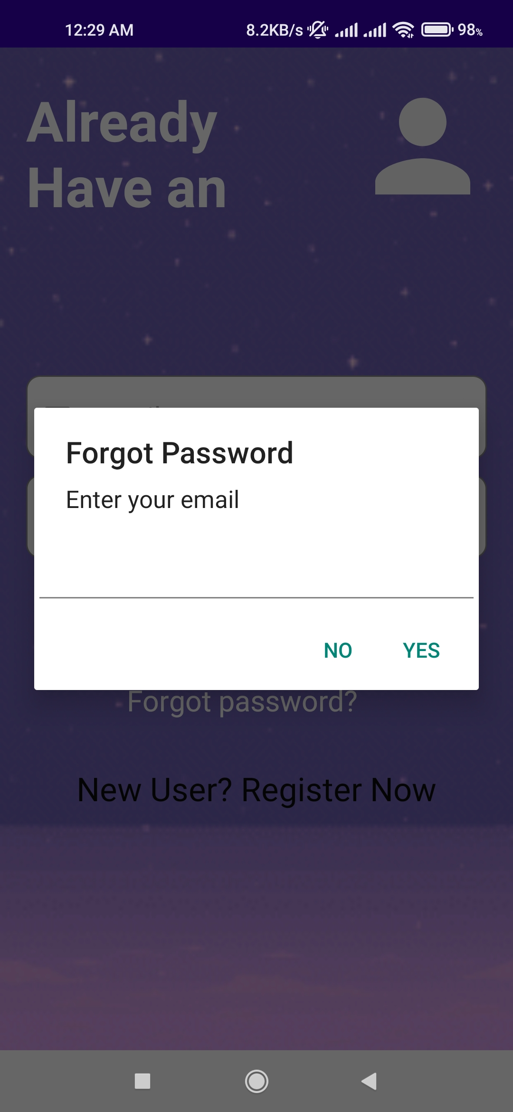
Login
Sign up
Forgot Password
If a person has an account, he or she can log in successfully here.
If a person does not have an account, he can create one here.
If a user forgets his password, he can create a new one through email.

Slide 3
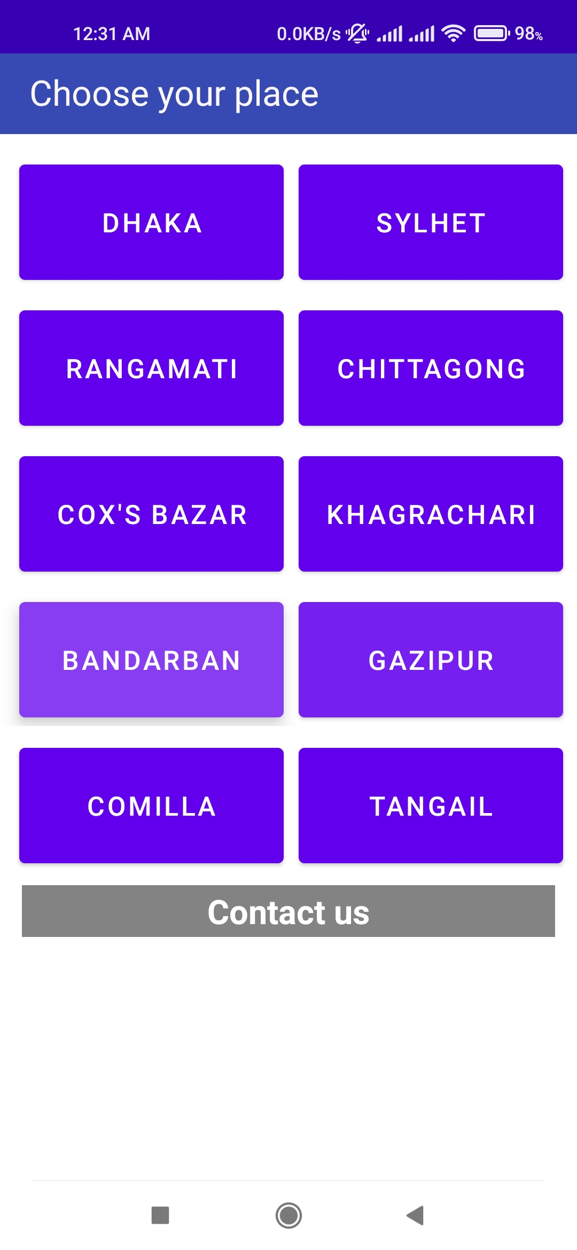
contact page is in under construction
Choose District
Here anyone can contact with us.
Here, an user can select any district he wants.

Slide 4
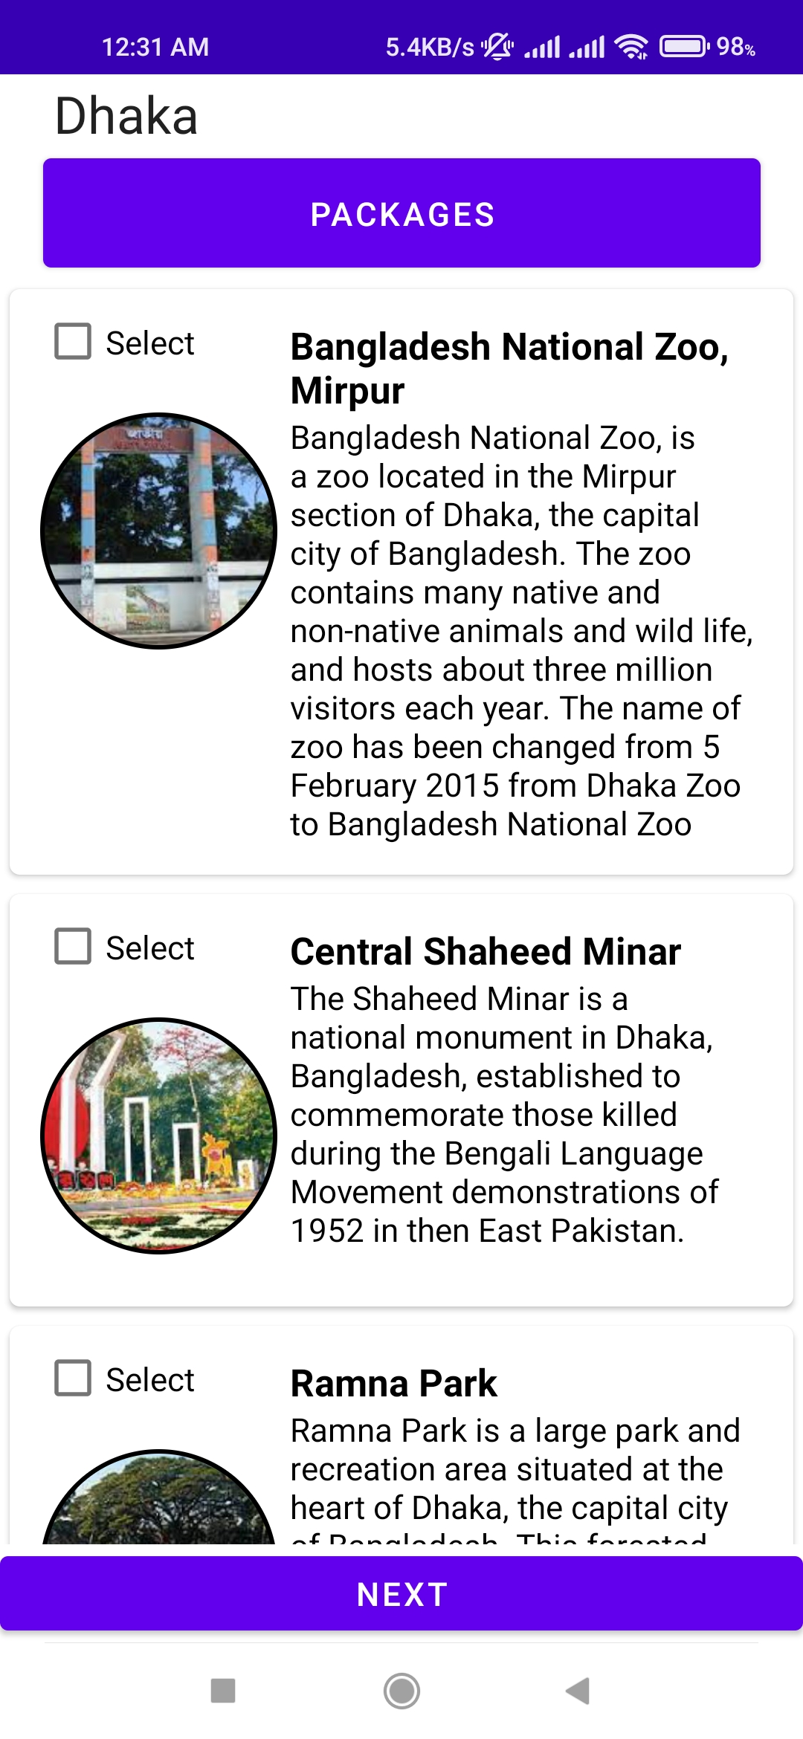
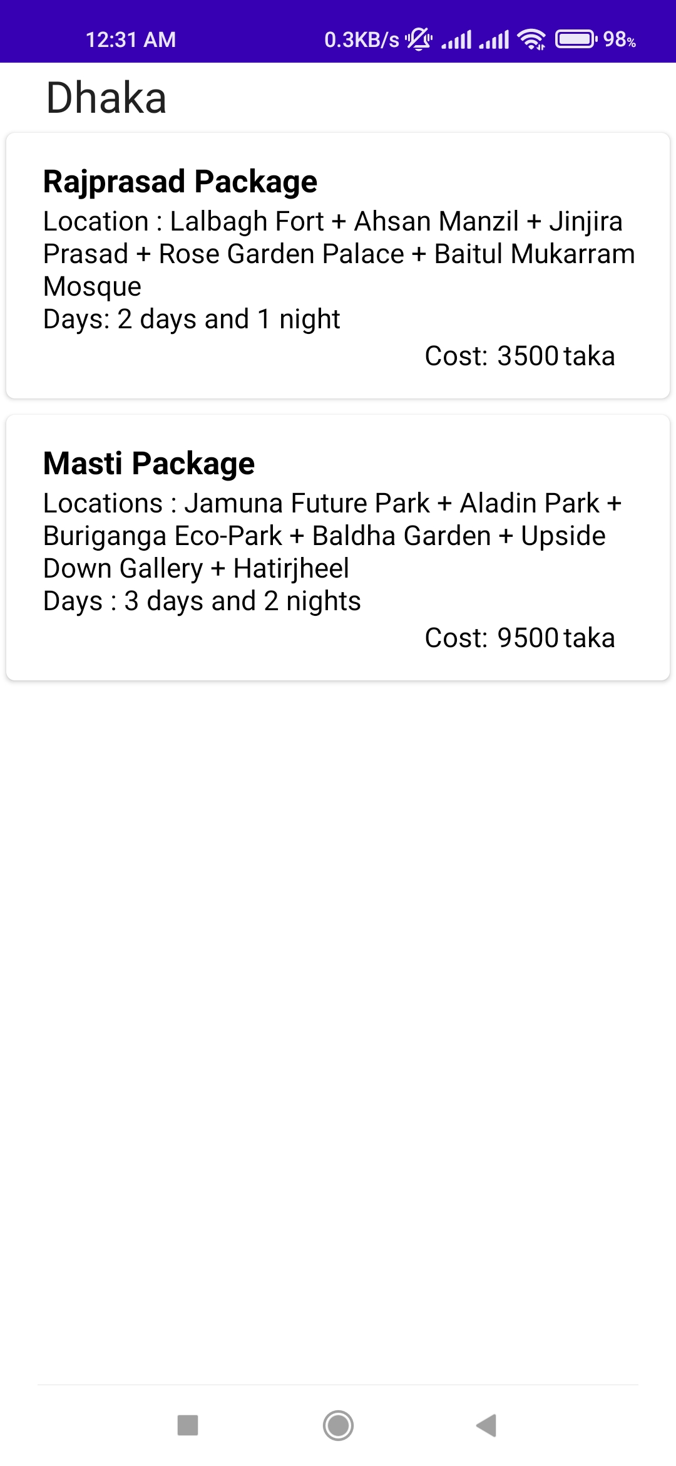
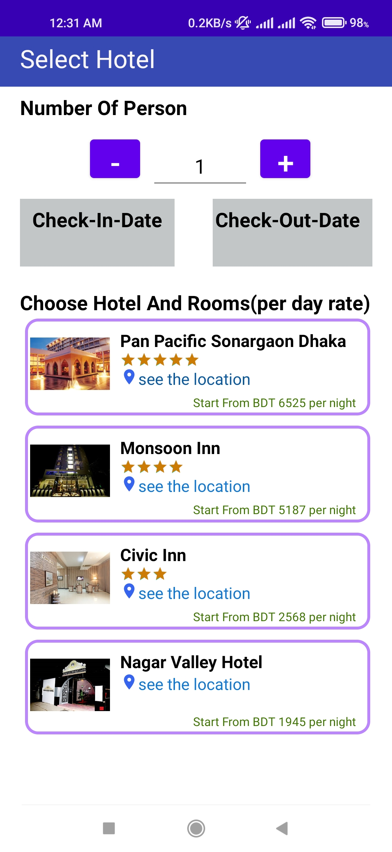
Under Construction
Select Hotels
Choose District
Package
If an user select some different spots and click on next button , then he can sellect dates,number of persons, hotels
A user has two options here:
1. He can pick from a lot of different places.
2. He has the option to select a package.
If he select package option then he will be able to take a package.

Slide 5
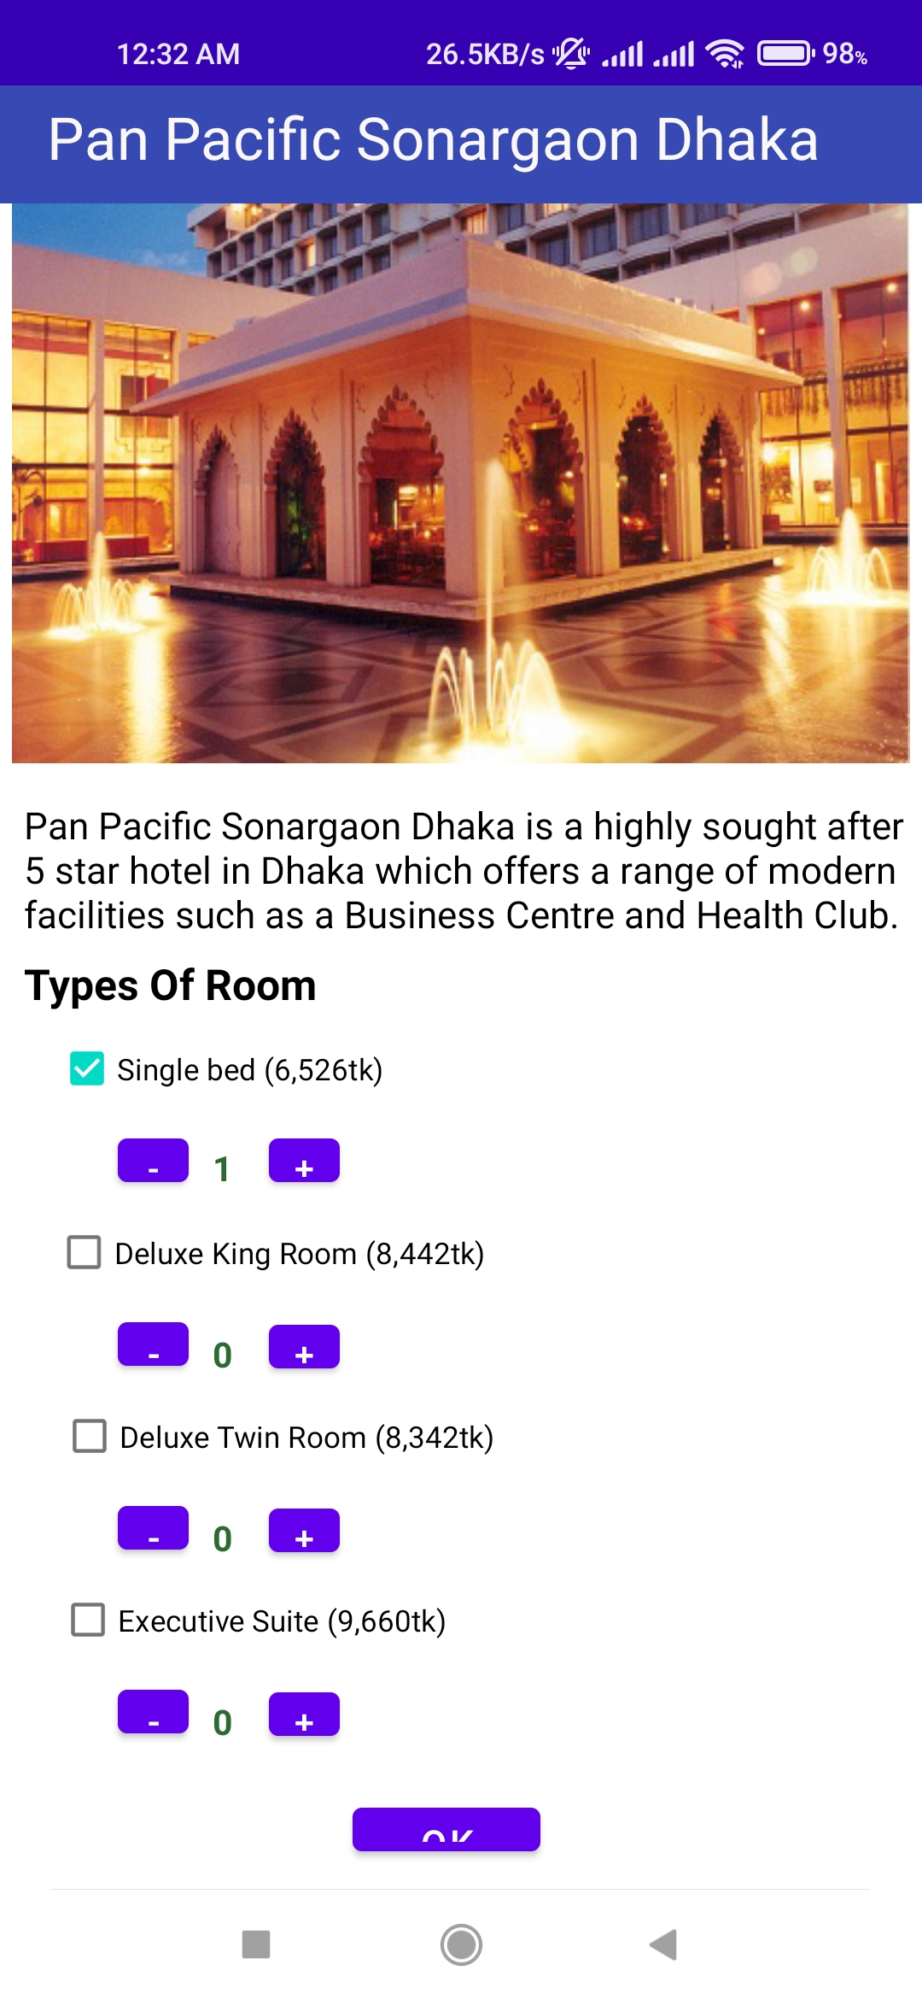
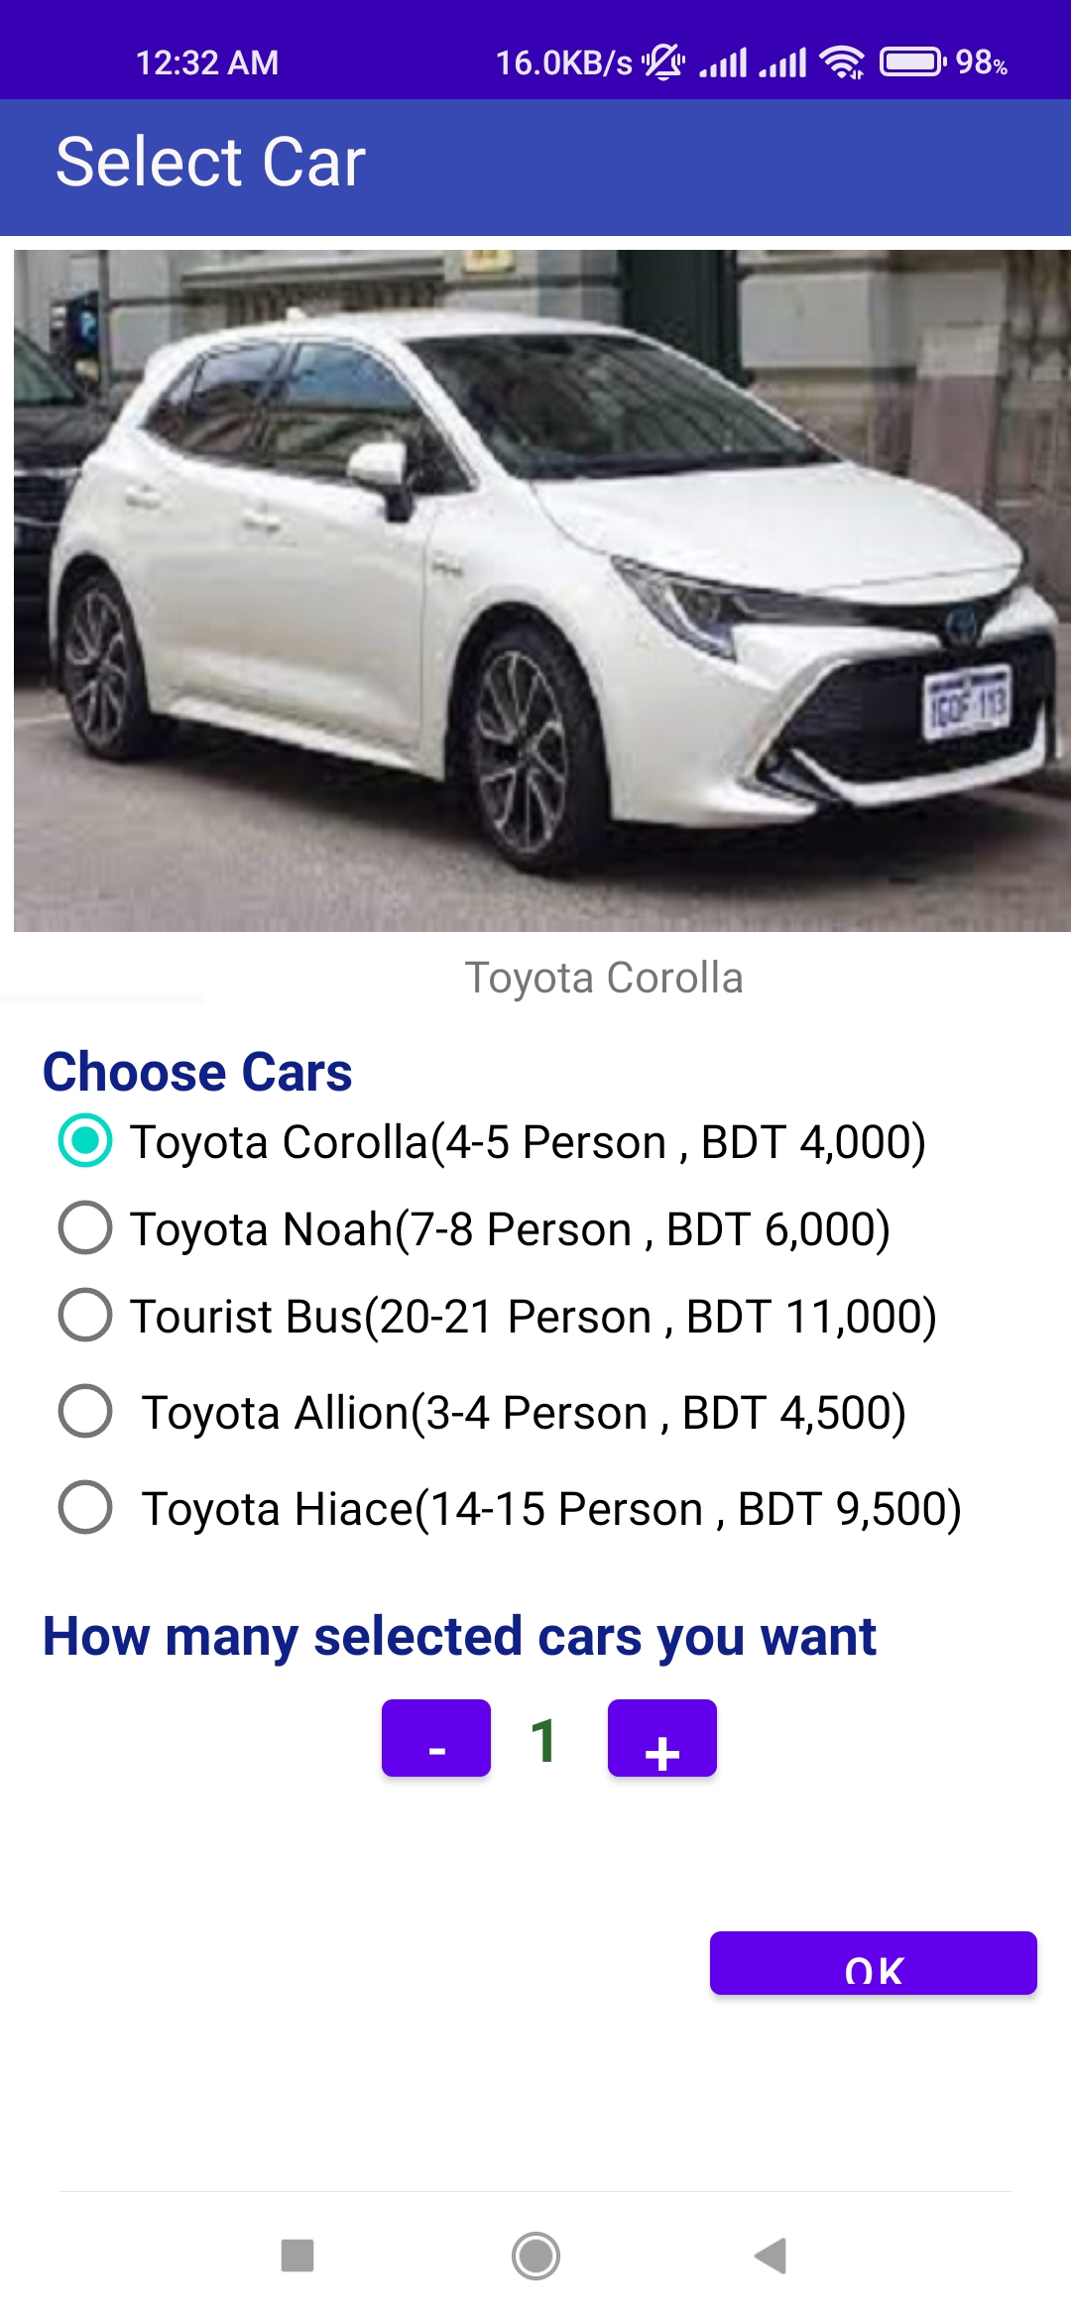
select Rooms Type
Car selection
Here he can choose rooms
Here he can choose a car

Slide 6
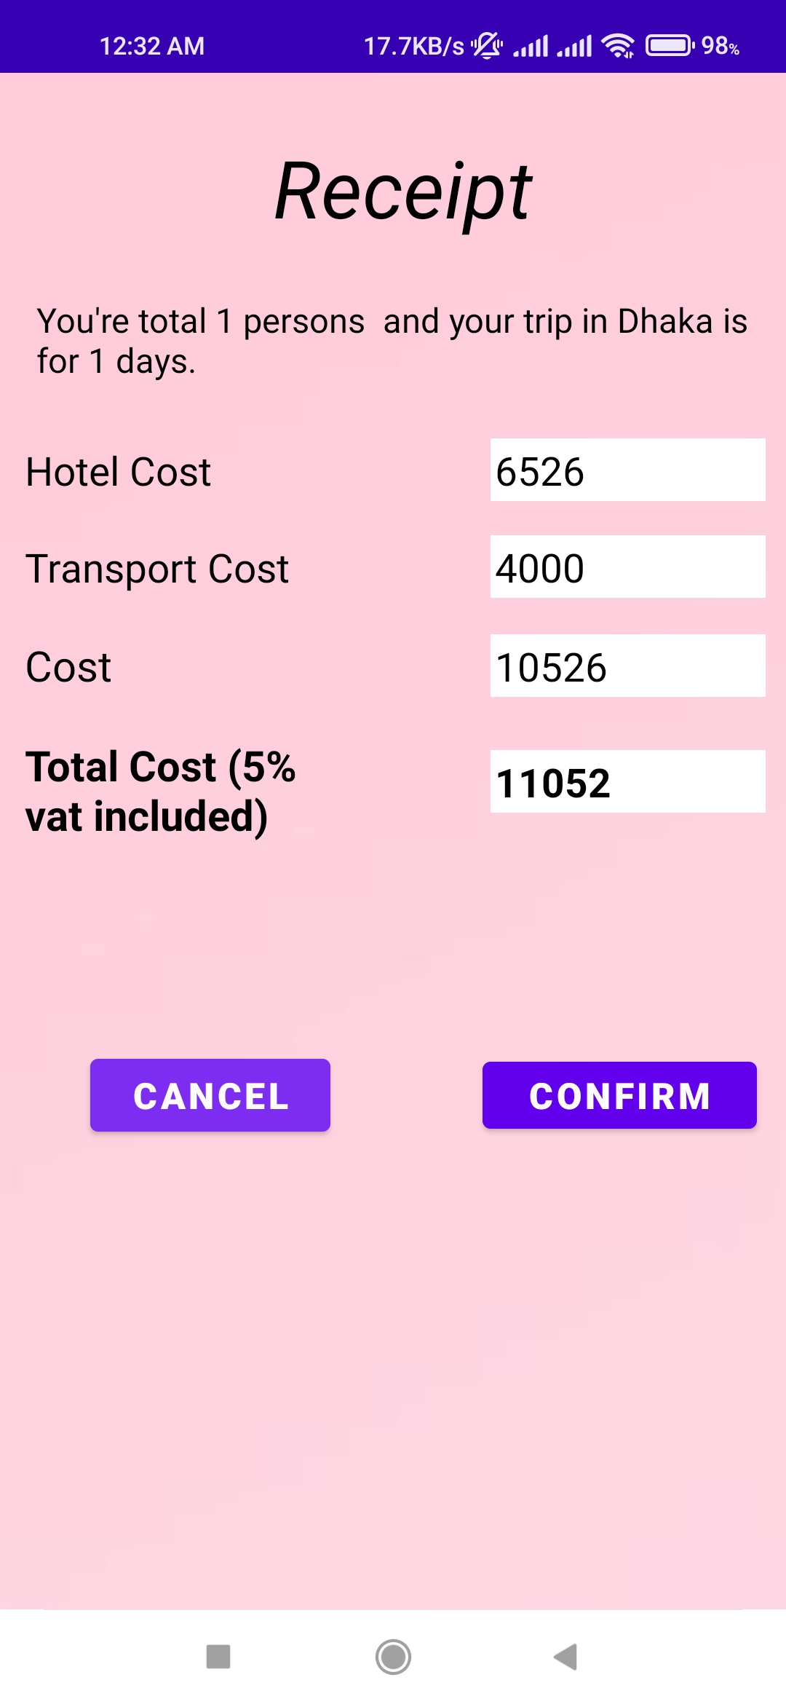
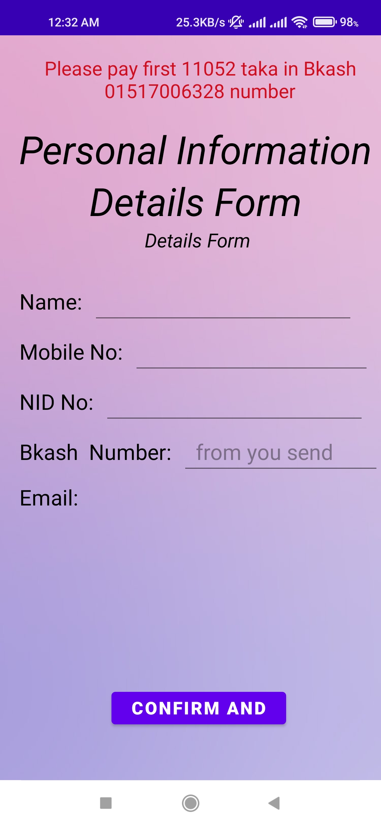
Receipt
Payment
On his selected items, an automatic bill will be generated.
Here, a user will enter some information and confirm it.

Slide 7
Under Construction Layouts:
1. Contact Us
2 Package 3. Payment
4. All District

Slide 8
THANK YOU
Any Question?

